Slide 1
#8: Collection of Underground App Distribution URLs on Telegram
Description:
Due to Telegram's anonymity and convenience, many underground apps related to pornography, gambling, and financial fraud take advantage of the platform for distribution.
Task:
1）Channel Discovery:
By using channel recommendation websites and bots, you can search for keywords like gambling or pornography to find lists of underground channels and groups.
Bot website: https://telegramchannels.me/zh/bots
Group sharing website: https://tgstat.ru/en/tags/geo

Slide 2
#8: Collection of Underground App Distribution URLs on Telegram
2）URL Extraction:
Use scripts to crawl chat records from these channels and extract URLs.
3）Download Page Identification:
Use scripts to visit the collected URLs and determine whether they are app download pages (keywords like iOS, Android, download, etc.)
The number of valid URLs collected should be at least 200.
4）Report:
Write a report about your experiments, encountered issues, and findings.(The list of channels and the final list of download URLs should be included.)
Reference:
- Guo, Yanhui, et al. "Beyond App Markets: Demystifying Underground Mobile App Distribution Via Telegram." Proceedings of the ACM on Measurement and Analysis of Computing Systems 8.3 (2024): 1-25.
Tutor: 王冠骁

Slide 3
#1: Detecting Dark Patterns in UI Screenshots
Description:
Design a tool that automatically detect potential dark patterns from recorded UI screenshots. The system should be capable of figuring out those deceptive UI designs.
Task:
1）Understand dark patterns: Dark patterns are deceptive or malicious UI designs that manipulate users into making decisions they would not have made otherwise.
- Visit https://www.deceptive.design/ for more details
- Select several types of dark patterns as the detection targets for your designed tool.
2）Acquisition of UI dataset:
- Download a public UI dataset. We recommend datasets specifically designed for dark pattern research by Di Geronimo et al. or Mansur et al.

Slide 4
3）Choose one technical approach:
Reproduce several multi-modal LLMs, such as Video-LLaMA, QWen 2-VL, then design prompts to instruct them in detecting dark patterns in videos/screenshots.
4）Reporting:
- Record the result of your experiments, organize and report your findings.
Notice:
1) For multi-modal LLMs, simple manual prompt adjustments are insufficient; you should design a more systematic and sophisticated prompt tuning process.

Slide 5

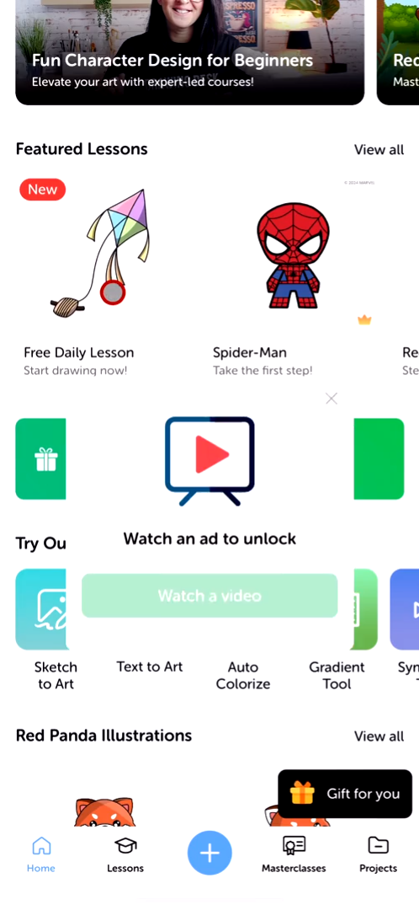
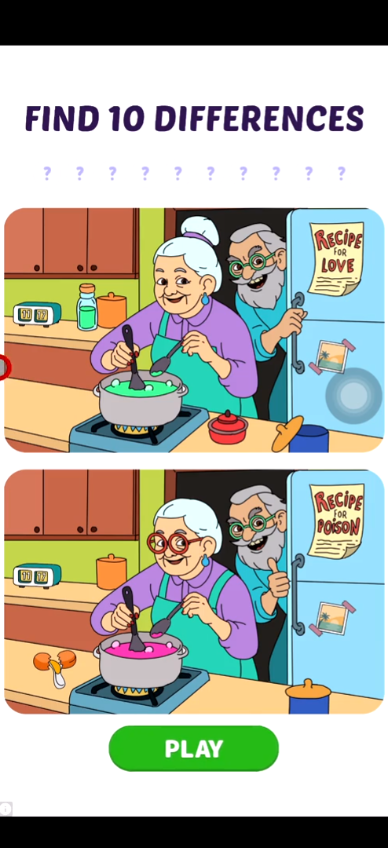
Reference:
- Dataset by Di Geronimo: https://zenodo.org/records/3601501
- Dataset by Mansur: https://zenodo.org/records/7644966
- Video-LLaMA: https://github.com/DAMO-NLP-SG/Video-LLaMA
- QWen 2-VL: https://qwenlm.github.io/zh/blog/qwen2-vl/
- UIGuard: Chen J, Sun J, Feng S, et al. Unveiling the tricks: Automated detection of dark patterns in mobile applications[C]//Proceedings of the 36th Annual ACM Symposium on User Interface Software and Technology. 2023: 1-20.
Dark Pattern Examples:
Watch an ad to unlock a feature
Purchase to remove ads
Ad
The user has to pay for removing ads
The user has to watch an ad for reward
An ad without any exiting option
Tutor: 尚宇轩

Slide 6
#2: RAG meeting LLMs
Large language models (LLMs), such as GPT-4, have demonstrated remarkable capabilities in generating coherent and contextually rich text. However, despite their impressive performance, they often struggle with delivering highly specialized knowledge outside their general training data.
Retrieval-Augmented Generation (RAG) addresses this limitation by enabling LLMs to access domain-specific external knowledge bases during inference.
In a RAG framework, the model retrieves relevant information from curated datasets or document collections tailored to a particular field, such as medicine, law, or finance. By incorporating this retrieved content into its generation process, the model can produce responses that are not only more accurate but also deeply specialized, effectively transforming a general-purpose LLM into a domain-expert system without the need for costly retraining.

Slide 7
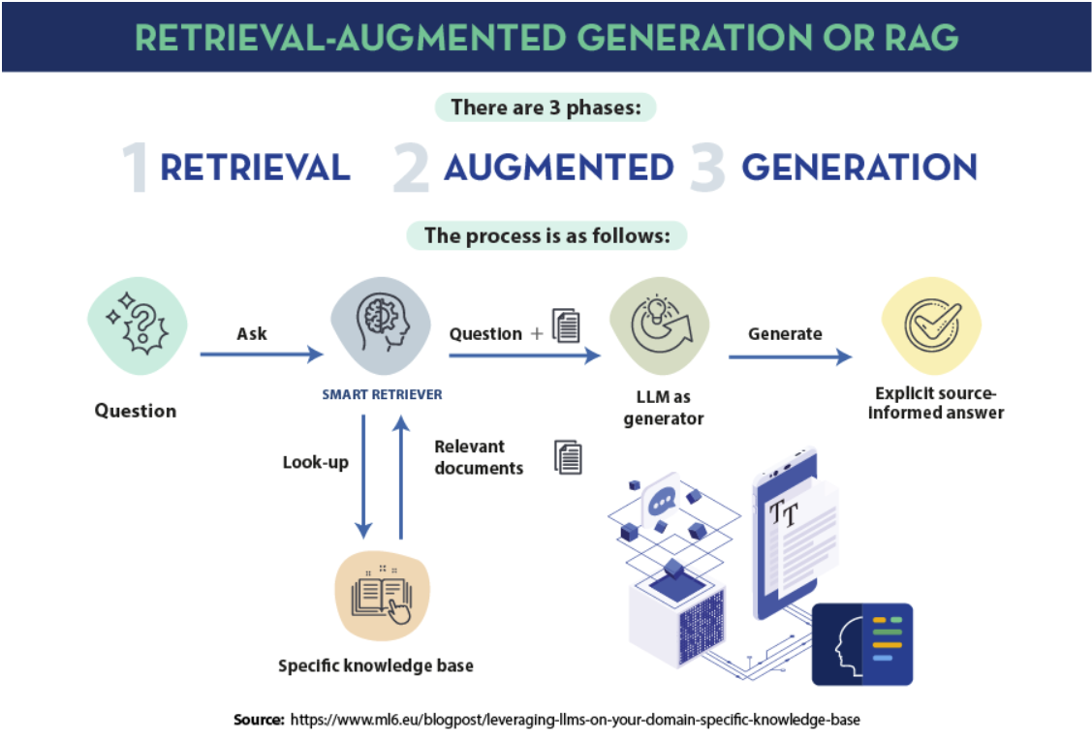
#2: RAG meeting LLMs

Slide 8
#2: RAG meeting LLMs
Tasks:
Read papers (those surveys) and do experiments to:
Study the definition of Retrieval-Augmented Generation (RAG).
List RAG techniques by category.
Research and review how RAG helps LLMs specialize in specific domains without retraining.
Try to complete a minimal RAG implementation!
Reference:
https://datos.gob.es/en/blog/rag-retrieval-augmented-generation-key-unlocks-door-precision-language-models
Survey: https://dl.acm.org/doi/abs/10.1145/3637528.3671470
Survey: https://arxiv.org/pdf/2409.14924
Survey: https://arxiv.org/pdf/2402.19473
https://python.langchain.com/docs/tutorials/rag/
https://arxiv.org/abs/2005.11401
https://github.com/deepset-ai/haystack
Tutor: 王嘉成

Slide 9
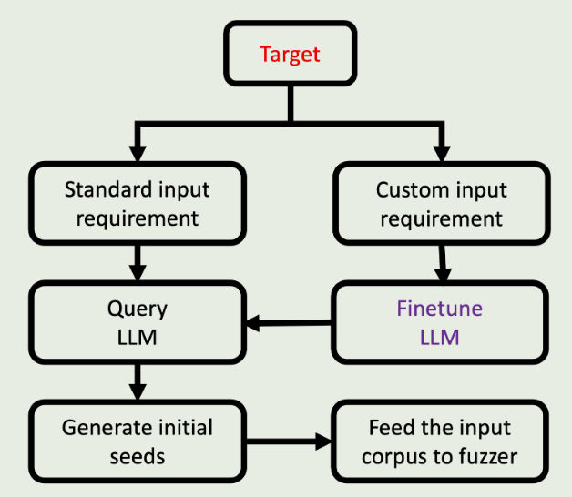
#3: LLM-Optimized Fuzz Testing for Embedded Software
Background:
Traditional fuzz testing relying on random mutation suffers from low syntax compliance and inefficient valid path exploration.
As a core component of embedded devices, BusyBox's security directly impacts IoT ecosystems.
This project focuses on applying Large Language Models (LLMs) to structured seed generation, aiming to improve fuzz testing's code coverage and vulnerability discovery efficiency through semantic-aware test case generation.

Slide 10
#3: LLM-Optimized Fuzz Testing for Embedded Software
Task:
​​ Target Selection​​
Select common embedded components (e.g., awk/dc modules in BusyBox) as test subjects
​​ LLM Seed Generation​​
Choose appropriate LLMs to generate initial seeds complying with target syntax
Compare structural validity between random seeds and LLM-generated seeds
​​ Fuzz Testing Execution​​
Conduct coverage-guided testing using AFL++ framework
​​ Result Analysis​​
Measure code coverage improvement and crash triggering efficiency
Validate path exploration capability of LLM-generated seeds
Reference:
Fuzzing BusyBox: Leveraging LLM and Crash Reuse for Embedded Bug Unearthing, USENIX Security 2024
CKGFuzzer: LLM-Based Fuzz Driver Generation Enhanced By Code Knowledge Graph, https://arxiv.org/abs/2411.11532
AFL++: https://github.com/AFLplusplus/AFLplusplus
Tutor: 沈彦冰

Slide 11
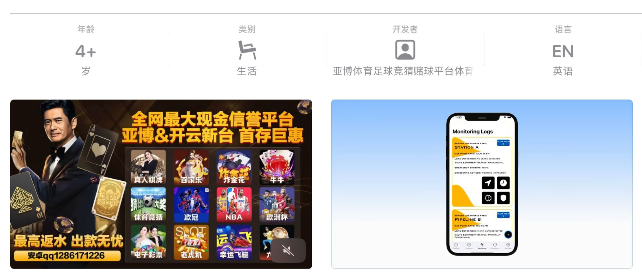
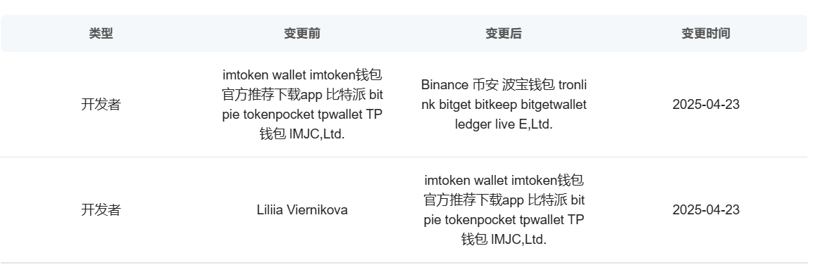
#4: Detecting and Analyzing Auto-Redirect Apps on the App Store
There exists a special category of suspicious and potentially illicit iOS apps on Chinese App Store. These apps share several common traits:
They are often published under suspicious developer names.
Their App Store screenshots contain promotional content, which is often questionable or suggestive.
Once installed and launched, they automatically redirect users to a specific URL in Safari, effectively acting as a "jumping pad" to external content.

Slide 12
#4: Detecting and Analyzing Auto-Redirect Apps on the App Store
Research Goal:
Identify Redirect Apps:
Use Qimai[https://www.qimai.cn] to find apps that match the above behavior pattern.
Collect and Analyze Metadata
Gather data such as app name, bundle ID, genre, and developer info.
Analyze to uncover patterns existing in naming, categories, and promotional strategies.
Identify each app’s surface-level disguise through description and metadata analysis.
Infer its potential true functionality by extracting and analyzing keywords from the developer’s name.

Slide 13
#4: Detecting and Analyzing Auto-Redirect Apps on the App Store
Research Goal (continued):
Behavior Analysis via IPA Files
Download IPA files and extract redirect URLs.
Conduct basic infrastructure analysis (e.g., domains, IP distribution).
You may automate parts or the entirety of this process using tools such as ipatool-py, tidevice, and Appium.
Monitor App Evolution
Track changes over time, including developer name modifications and (re)uploads or takedowns.
Through this analysis, you are expected to provide unique insights for the governance of such apps.
Tutor: 林虹妤

Slide 14
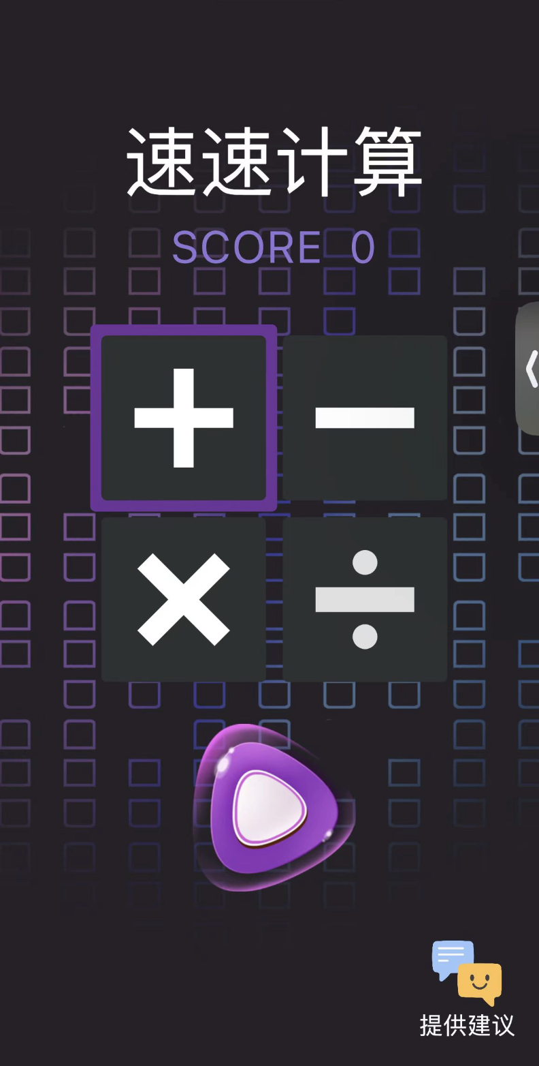
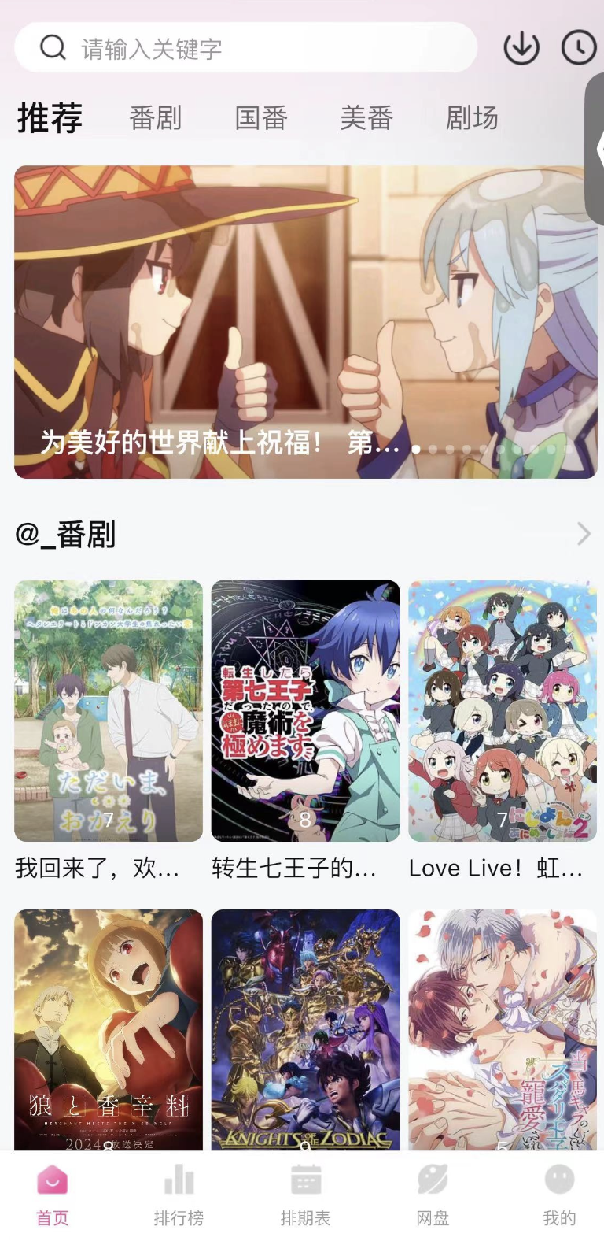
#5: Cluster analysis of the Chameleon app family
Chameleon Apps: using a method of disguising malicious or illegal apps as benign apps to evade censorship (It looks like the App is wearing a vest), and activating hidden UI or interfaces through specific triggering events.
Chameleon apps often share core functionality but differ in appearance. This raises the question: do they exhibit higher code similarity, and can such similarity help uncover unknown Chameleon apps?
Original UI
Real UI after triggering

Slide 15
#5: Cluster analysis of the Chameleon app family
Research Goal:
You will be provided with unpacked IPA files from three categories: known Chameleon apps, benign apps, and a set of unknown apps (some of which may be Chameleon apps).
You are expected to:
Investigate potential methods for binary similarity analysis (e.g., BinDiff), and summarize their features and trade-offs.
Perform static analysis on the IPA files to generate pairwise similarity scores.
Conduct statistical analysis on the similarity scores, and explore techniques such as clustering or dimensionality reduction visualization (e.g., feature matrix of similarity scores between unknown apps and all known Chameleon + benign apps).
Identify typical Chameleon app "families", analyze the effectiveness of binary similarity in detecting Chameleon apps, and evaluate its limitations.
Tutor: 林虹妤

Slide 16
#6: LLMs Privacy Leakage
Large language models (LLMs), such as GPT-4, have revolutionized natural language processing with their ability to generate human-like text. However, this remarkable capability comes with significant privacy concerns.
Privacy leakage in LLMs refers to the unintended release of sensitive information that the model may have encountered during its training phase.
This issue arises because LLMs are trained on vast datasets, which often include personal data, confidential business information, and other sensitive content. When these models are queried, they might inadvertently reproduce this information, leading to privacy breaches.

Slide 17
#6: LLMs Privacy Leakage
Task:
Study the definition of privacy leakage, and the training dataset for LLMs
List privacy leakage techniques for each category of restrictions
Research and review the current status of privacy leaks in different large language models and techniques for obtaining personal privacy
Try to attack a LLM to get some private information.
Reference:
https://www.computer.org/csdl/proceedings-article/sp/2023/933600a346/1OXH3fH5lIs
https://www.jiqizhixin.com/articles/2023-11-30-9
https://github.com/ydyjya/Awesome-LLM-Safety/blob/main/subtopic/Privacy.md
Tutor: 程帅

Slide 18
#7: App Eavesdropping
In recent years, with the widespread adoption of smartphones and rapid advancements in voice interaction technologies, an increasing number of mobile applications (apps) have obtained microphone access permissions, enabling them to capture ambient sound without the user’s awareness.
This behavior, often referred to as "app eavesdropping," typically involves the app activating the microphone—either continuously or intermittently—through background processes or permission misuse, without explicitly informing the user.
Many users have reported instances where, after casually discussing a product with friends, they soon received targeted advertisements for the same product on other apps.
App eavesdropping not only infringes on users’ privacy rights but also poses several potential risks, such as information leakage, digital discrimination, and unfair competition.
As such, it urgently calls for joint governance across technological, legal, and policy domains

Slide 19
#7: App Eavesdropping
Task:
Review relevant literature to investigate the types of technologies associated with app eavesdropping.
Conduct experiments to analyze whether commonly used apps are actually engaging in eavesdropping.
Attempt to reliably reproduce an eavesdropping mechanism in a specific app; if reproduction fails, analyze how apps may still deliver precise advertisements without actual eavesdropping.
Reference:
https://link.springer.com/chapter/10.1007/978-3-030-22479-0_6
https://doi.org/10.1177/20563051241288448
https://doi.org/10.1016/j.hcc.2024.100241
https://www.bilibili.com/video/BV1f6rVY7Ejf/ https://www.bilibili.com/video/BV1Sh411Y7nQ/ https://www.bilibili.com/video/BV1v54y1m7dh/
Tutor: 程帅

Slide 20
#9: Automated Exploration of Google Play Age Rating Rules from a Developer's Perspective
Background:
Age ratings for mobile applications are crucial for protecting underage users. Google Play employs a questionnaire-based approach to assess app suitability for different age groups, adjusting rating outcomes according to regional laws and regulations. However, the opacity of Google Play’s age rating rules for developers raises questions about their reasonableness. This project aims to analyze and evaluate the rationality and potential issues of Google Play’s age rating system by developing an automated questionnaire-filling and data collection tool.
Research Questions:
What are Google Play’s age rating rules?
Are these rules reasonable? Do they have potential flaws?

Slide 21
#9: Automated Exploration of Google Play Age Rating Rules from a Developer's Perspective
Tasks:
I. Automated Questionnaire-Filling Tool
Automated answer combination generation: Programmatically generate all possible answer combinations to ensure comprehensive coverage.
Simulated user interaction: Use Puppeteer/Selenium to automate questionnaire submission and extract results.
Rule flowchart generation: Develop a program to visualize rating rules based on answer-result mappings.

Slide 22
#9: Automated Exploration of Google Play Age Rating Rules from a Developer's Perspective
II. Data Analysis
Rule consistency evaluation: Assess whether different answer combinations leading to the same rating are logically justified.
Cross-country regulatory comparison:
Manually or via document summarization models (e.g., LLMs), compile age rating regulations from different countries.
Compare these with Google Play’s rules to evaluate thei (reasonableness).
Tutor: 孟澍

